Slide 1





CVD Prevention and West Yorkshire and Harrogate Healthy Hearts Webinar
Reducing cardiovascular disease incidents and inequalities

Slide 2
CVD Prevention and West Yorkshire and Harrogate Healthy Hearts Webinar
Reducing cardiovascular disease incidents and inequalities
Welcome
Dr Youssef Beaini
CVD Clinical Lead for WY&H Healthy Hearts
CVD lead Bradford and AWC CCGs
GPSI Cardiology
GP at Ridge Medical Practice, Bradford
Honorary Senior Lecturer, University of Bradford

Slide 3
Purpose and Aims
To raise awareness about the CVD challenge and the Healthy Hearts Project across West Yorkshire and Harrogate
To share with you the work of the Healthy Hearts project to address part of the challenge and to ask for your support
To highlight the healthy hearts and PHE support resources
Share the key messages of the program for our peers and the public
To generate awareness so we can make the biggest impact

Slide 4

Learning Objectives
At the end of the session participants will:
Have a brief understanding of CVD prevalence
Understand the main aims of WY&H Healthy Hearts project
Be familiar with the local hypertension guidance and clinical searches
Know how to access various support resources
Supports CPD (2 CPD learning points) including review of supporting documents after webinar

Slide 5
Agenda
Strategic context of CVD prevention and Healthy Hearts project
  Dr Youssef Beaini, GP and Clinical Lead for Healthy Hearts (1pm -1.02pm)
Hypertension Clinical Guidance Dr Youssef Beaini (1.02pm -1.12pm)
Healthy Hearts Support Resources
  Pete Waddingham, Programme Manager – Y&H AHSN (1.12pm -1.15pm)
GP perspective on the Healthy Hearts project
  Dr James Gray, Calderdale CCG (1.15pm -1.20pm)
All Our Health and key public health messages
  Karen Pearson, CVD Programme Manager, PHE Yorkshire and Humber (1.20pm – 1.30pm)
Q&As (1.30pm – 1.40pm) *All slides will be made available after

Slide 6
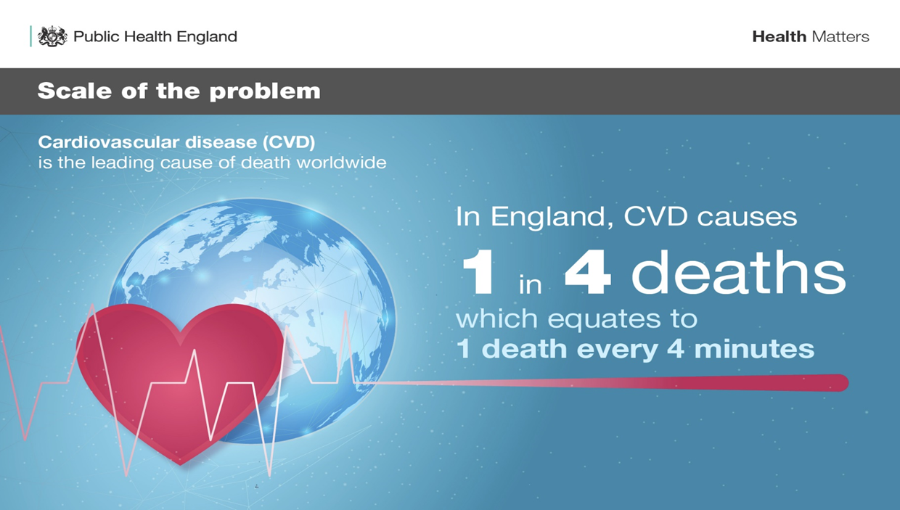
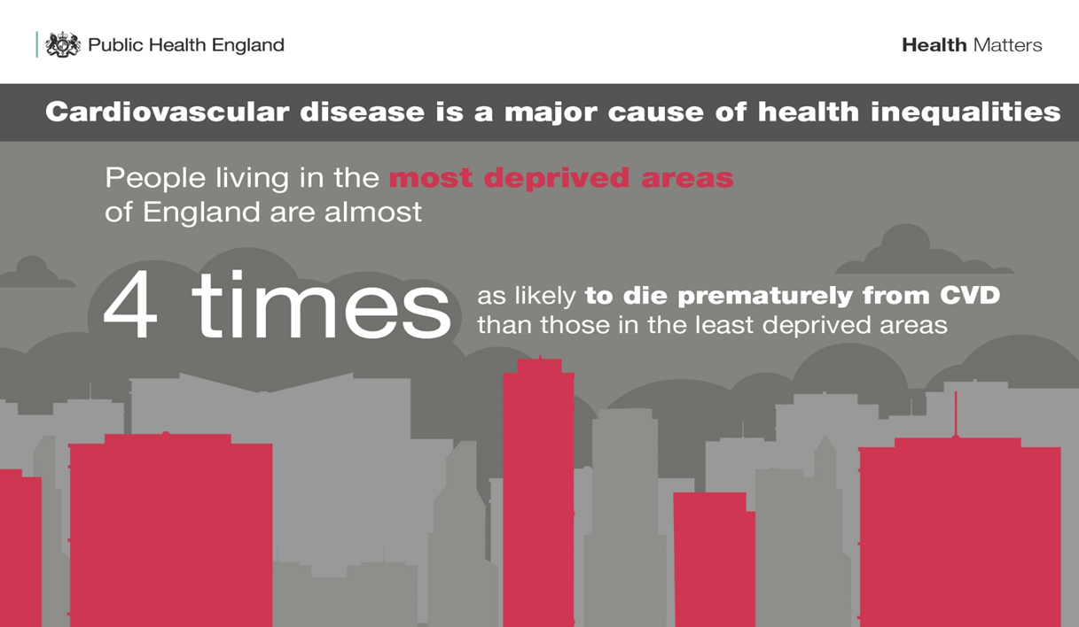
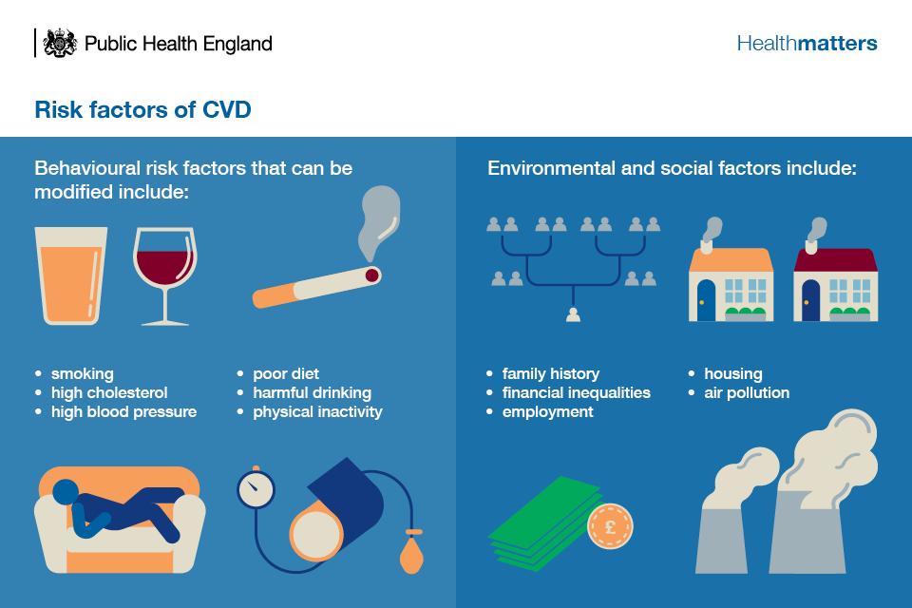
CVD is a major burden of ill health
In Yorkshire and the Humber, high blood pressure is by far the biggest risk factor for deaths from CVD, followed by high cholesterol, high fasting plasma glucose and high BMI.
There is an ambition across West Yorkshire and Harrogate to reduce CVD incidents such as heart attacks and strokes by over 1,100 (10%) by 2021, an estimated reduction of 350 strokes and 800 heart attacks
Notes:
Scale of the issue:
In the West Yorkshire and Harrogate Health and Care Partnership area alone, more than 600,000 people are affected by high blood pressure (hypertension) - a leading cause of heart disease and stroke.
We estimate that 256,000 people (9.8%) have high blood pressure but remain undiagnosed, while 60,517 people have an irregular heartbeat (atrial fibrillation) and nearly 49,000 people have experienced a stroke or mini-stroke (TIA).
People in WY&H have a shorter average life expectancy than the rest of England. Males lives are, on average, 1 year shorter than the England average and females
almost 10 months shorter.
Life expectancy varies between the places across WY&H and also within them. Published figures for the 2009-2013 period show that there is a 17 year difference in
life expectancy in males and females within different areas across the 382 smaller community areas that make up WY&H.

Slide 7
WY&H Healthy Hearts Project
West Yorkshire and Harrogate Health Care Partnership (HCP) agreed to prioritise improvements in CVD outcomes through joint working and sharing resources and learning.
The WY&H Joint Committee of CCGs agreed in May 2018 to a three phased approach:
Phase 1 – Hypertension (Launched April 19)
Phase 2 – Lipid/Cholesterol management (Launch October 19 – April 20)
Phase 3 – Glycaemic Control /diabetes (Launch Autumn 2020)

Slide 8
Phase One - Hypertension
Increasing recorded prevalence of hypertension:
Patients who have high blood pressure readings which may be hypertension but who are not yet diagnosed
Identify patients already on anti-hypertensive medication but not coded on GP QoF registers
Treatment optimisation:
Identify and optimise treatment of patients already diagnosed with hypertension

Slide 9
Treatment Guidance
Why local guidance (for hypertension)?
Still a huge number of people with high BP not achieving their blood pressure target, despite years of national guidance
NICE guidance is only one type of guidance that is used by UK cardiology specialists. (For majority of patients, NICE has now updated its guidance to be in line with our Healthy Hearts guidance)
European Society of Cardiology is one of two world leaders of cardiology and its guidance is routinely used in specialist cardiology in the UK
There is clear and robust evidence that the main benefit from hypertension treatment is from the improvement in blood pressure, not the drug chosen
**Local guidance developed is for Uncomplicated Hypertension**

Slide 10
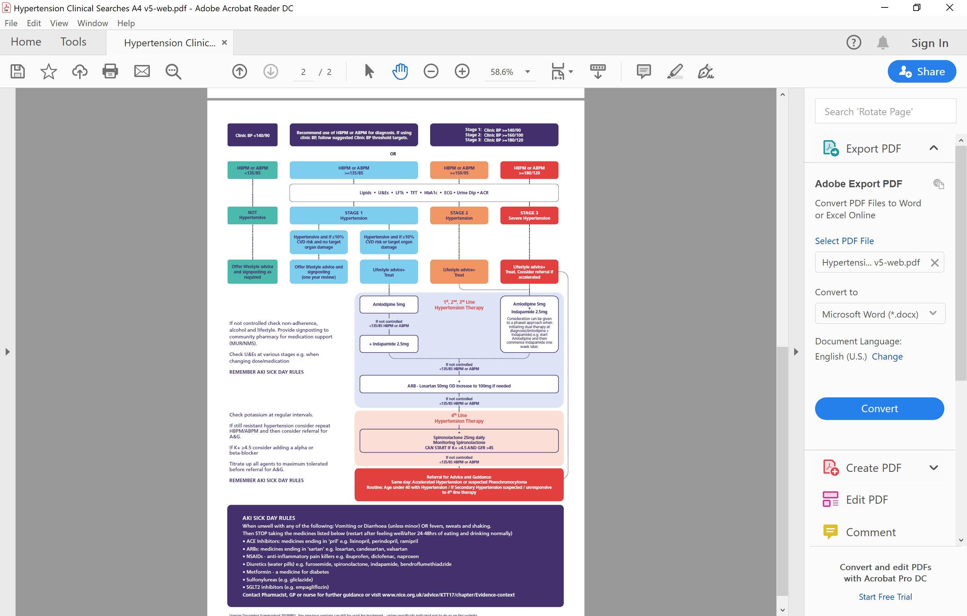

Slide 12
Hypertension Treatment Guidance
**Minor changes are being made to Hypertension Guidance – the revised guidance will be available and published on our website soon (estimated 16th December)
The current guidance can be found here

Slide 13
Alignment with new NICE Guidance
Current NICE steps 1-3:
Step 1 is treatment with a Calcium Channel Blocker or ACEi/ARB (depending on age or if Afro Caribbean).
Step 2 is add ACEi, ARB or indapamide (for most patients i.e. >55yrs)
Step 3 – all three drug classes CCB + ACEi/ARB + indapamide
NICE are now more clear that spironolactone is first line for resistant hypertension (if potassium <4.5). If not suitable for spironolactone, then addition of Alpha or Beta Blocker.
This is exactly in keeping with WY&H treatment guidance.
*Note the WY&H Hypertension treatment guidance is not mandatory and clinical judgment continues to be used as with all medicine.

Slide 14
Governance of local guidance
Very extensive local clinical consultation – led by a named lead GP on each CCG board, including consultation with LMC and WYAAT
Public Health England
Three 'Area Prescribing Committees' rigorous review and sign-off
Pharmacy Leadership Group review and sign-off
Review and sign-off by WY&H Standardisation programme
Review and sign-off by WY&H Joint Committee of CCGs
Recently reviewed with NHSE regional director too

Slide 15
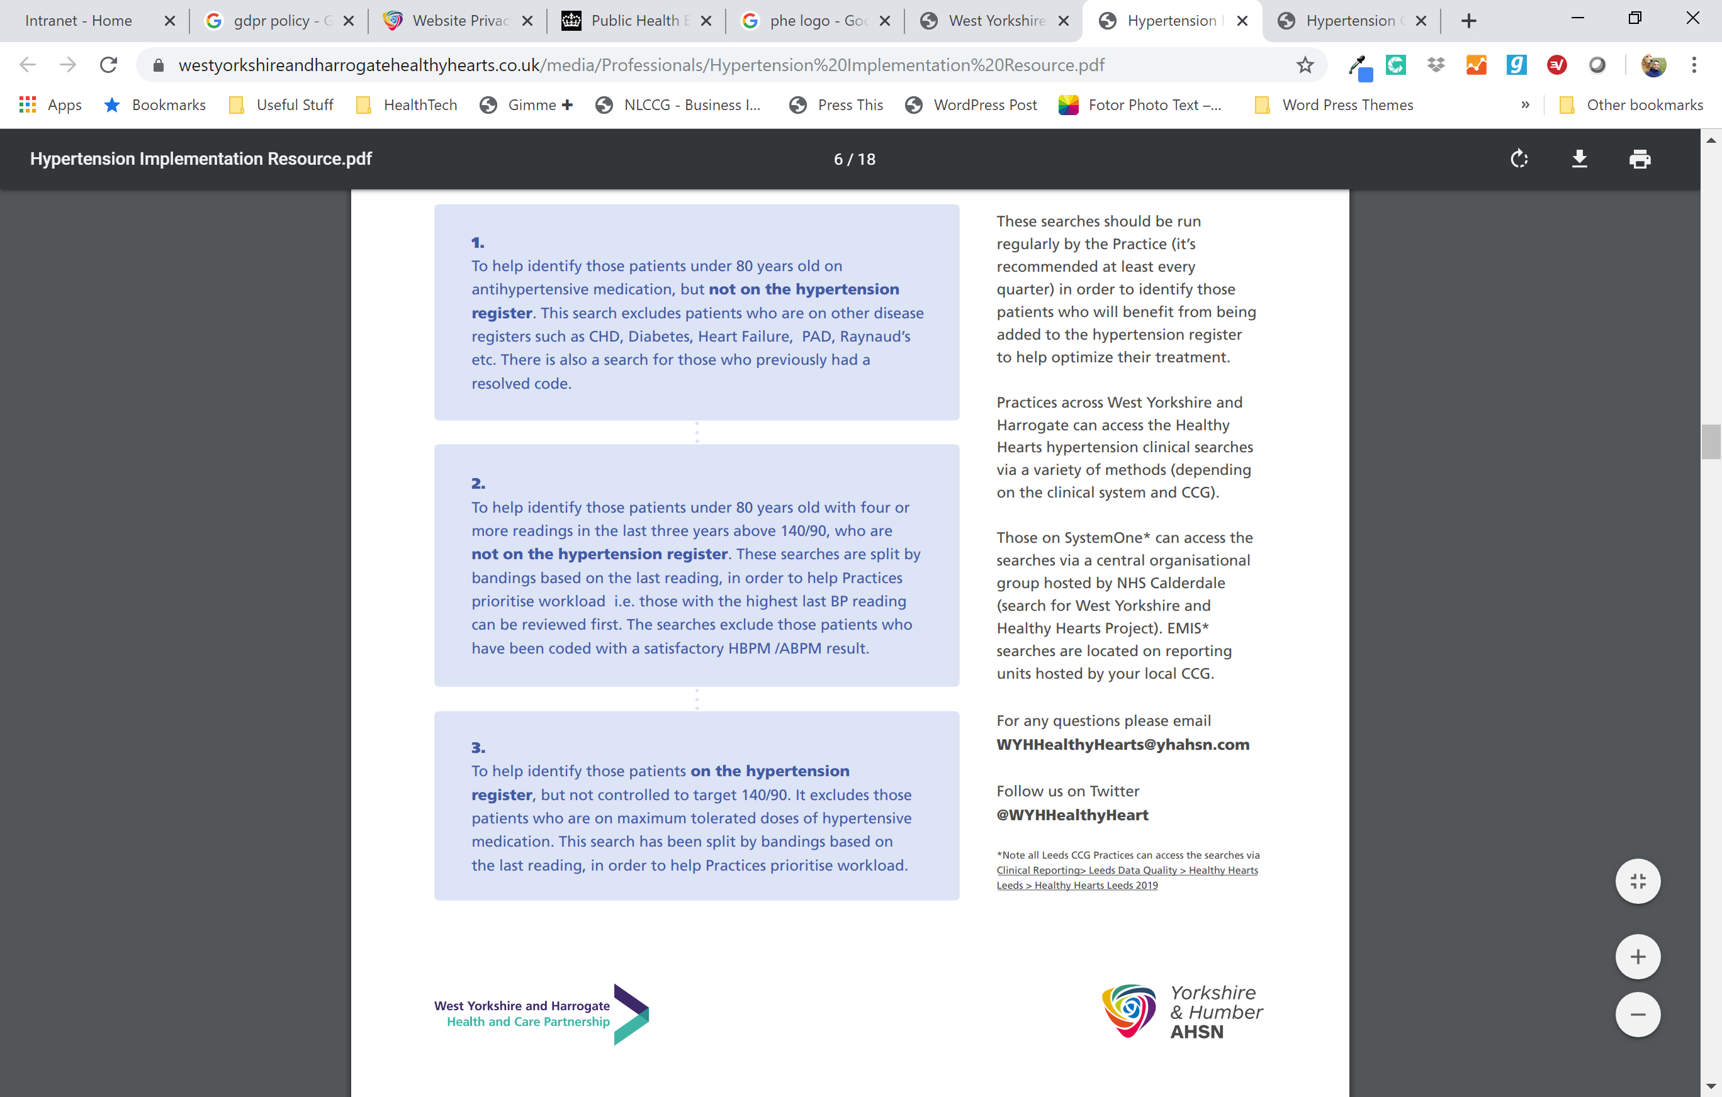
Three Main Clinical Searches
Details on how to access here

Slide 16
Healthy Hearts Support Resources
Healthy Hearts Website
Information for both patients and professionals
The Clinical Guidance and support documents are on the website
Resources for Cholesterol are also on the website ready for phase two launch (subject to each CCG)
CCGs have incorporated this guidance into local IT guides/templates etc (e.g. GP Assist in Bradford and AWC and Ardens in Calderdale / Greater Huddersfield and North Kirklees)
Developing all the time – so continue to check back!

Slide 17
GP / Primary Care Perspective
Dr James Gray (GP and Calderdale CCG Board Member)
Guidance is easy to use and effective
Searches are useful and don’t take too much time to run
Clinical judgement can always be exercised
It is a developing project and feedback is vital
Project has already had impact 4,500 patients added to hypertension registers and 3,500 now controlled to 140/90 in just 6 months
= Total of 8,000 patient interventions so far

Slide 18
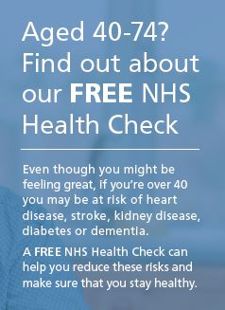
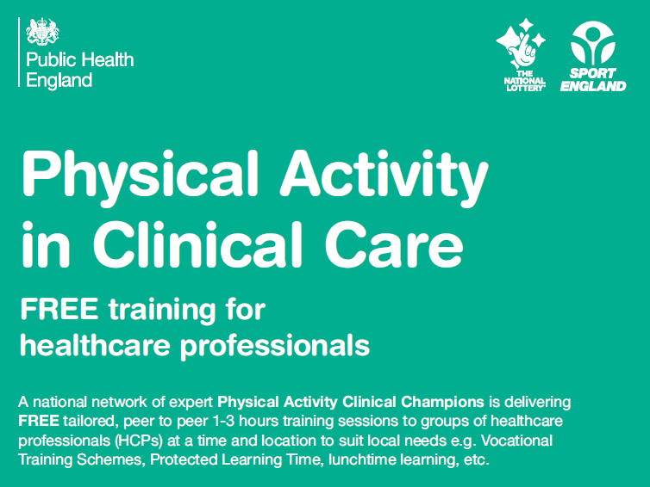
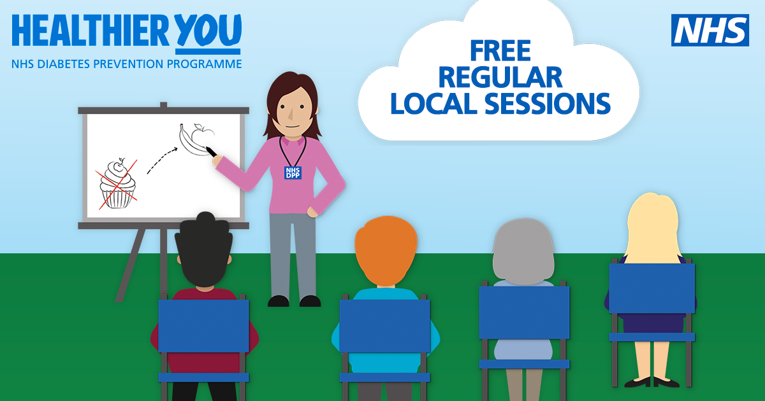
How can health care professionals support people to live well?
We recognise that modern life can make it hard to be healthy; the way people live their lives, the impact of their surroundings and the challenges faced with on a daily basis can make it difficult to live well.
We want to encourage people to make small changes and there’s lots of resources to help them, and you.
Notes:
We mustn’t forget the value of NHS Health checks. The NHS Health Check offers an opportunity for people in midlife to assess their risk of CVD and make lifestyle changes that can prevent and delay the onset of CVD. As well as helping individuals to recognise and tackle their behavioural risk factors, it also provides a systematic approach to identifying people with previously undiagnosed high risk conditions.
Two large-scale national evaluations of the programme have shown that there is not a social gradient in the coverage of this prevention programme. This is hugely important as most universal healthcare interventions are commonly assessed by our more affluent communities. This shows that the programme is achieving its objective of tackling health inequalities and addresses early concerns that the NHS Health Check would be a programme for the ‘worried well’.
However, we know that more could be done to ensure that we improve coverage to younger populations and see more men taking up the offer of the NHS Health Check.
An evidence synthesis which looked at 68 papers, undertaken by members of the Primary Care Unit, University of Cambridge and supported by RAND Europe found that coverage is consistently higher among:
older people
individuals from the poorest communities
people with a family history of coronary heart disease

Slide 19
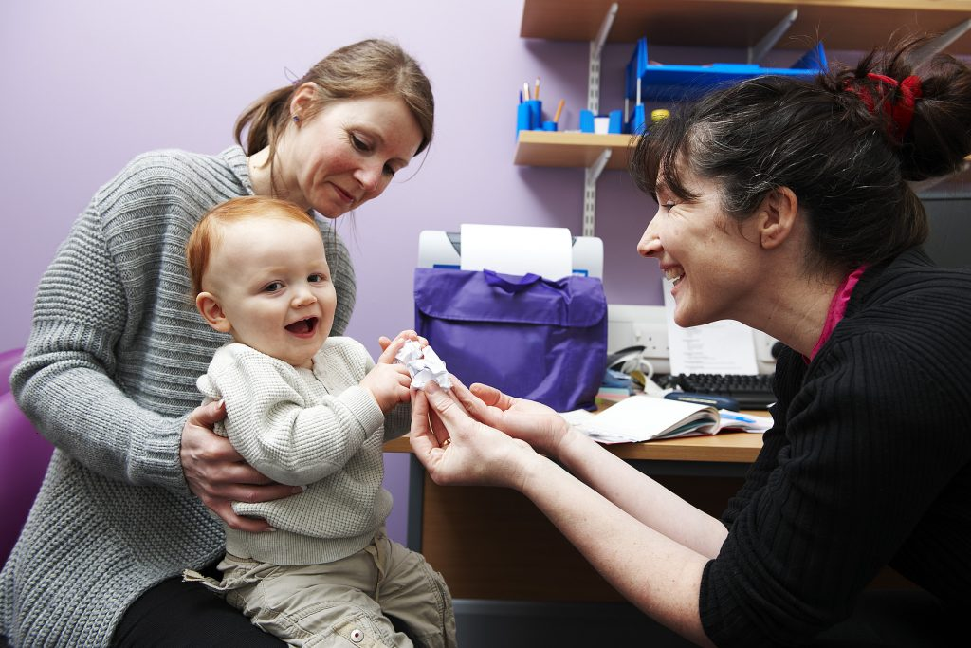
Public attitudes – talking about prevention
  PHE carried out some large scale survey work to look at:
  who patients trust to give them advice on how to stay healthy
  whether people proactively ask for this advice, and from who
  which professionals the public expect to receive advice on how to stay healthy from
  whether some topics are
  deemed more acceptable to
  be asked about than others
Notes:
I want to tell you about the most recent resource to help you

Slide 20
What we found
There’s a high level of trust in advice from healthcare professionals BUT one third (33%) of people have never asked a professional for advice on how to stay healthy.
Advice is expected from doctors and nurses: most people expect to be given advice from doctors without asking for it, but fewer report receiving this advice. For instance, three quarters (76%) expect advice from GPs – but less than half (43%) say they have received it.
But people are not in the habit of asking for advice.
Most people feel it is ‘acceptable’ to receive healthy living advice from healthcare professionals across a range of physical and mental health topics: GPs 91%; Hospital doctors 91%; nurses 88%; other healthcare professionals 84%; dentists 79%; pharmacists 73%

Slide 21
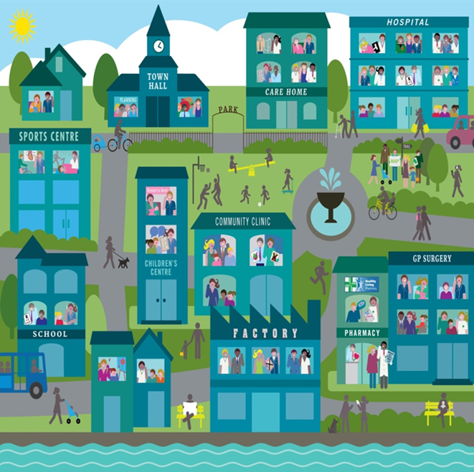
‘All Our Health’ (AOH) : A model for change
Call to action/social movement
Supporting health promoting practice through:
  Gov.uk resources on 27 topics for evidence into practice
  Learning and education for all health and care professionals and CPD
Building leadership and capability
Working with a range of professional groups across the NHS
Search online for “All Our Health”
Notes:
Developed to help overcome some of the barriers HCP tell us about starting conversations about living well:
Difficulty in starting and holding ‘hard conversations’ → tools, skills and confidence to do so – See MECC
Lack of confidence in own knowledge compounded by lack of easy access to evidence → bite-sized, easy to understand, evidence based trusted resources
Time pressures → based on feedback, each resource shouldn’t take more than 5/10 minutes to digest and is intended for health and care professionals to dip in and out of

Slide 22
Resources to support you
Training
All our Health Framework, Public Health England – Free bite sized e- learning sets on a range of prevention topics. It provides the evidence and information to help you embed prevention in your day to day work. https://www.e-lfh.org.uk/programmes/all-our-health/
Physical activity – This free locally delivered training focuses on practical tips to easily integrate this into every day clinical practice. Contact physicalactivity@phe.gov.uk
Motivational interviewing - This free on-line module (1hr) explains what motivational interviewing is, its uses, and explanations. https://learning.bmj.com/learning/module-intro/motivational-interviewing.html?moduleId=10051582
Moving Medicine - An innovative online resource, Moving Medicine, developed with health charities to provide evidence-based resources for conversations with patients with common conditions https://movingmedicine.ac.uk/
Websites for more information and signpost the public to
One You - One You is the Public Health England website designed to help people get healthier and feel better with free tips, tools and support. One You can help people make small, practical changes that fit in with their life. https://www.nhs.uk/oneyou/
West Yorkshire and Harrogate Healthy Hearts Website – Keeping information about Heart Health in one place. The website provides information about the healthy hearts programme as well as useful information on hypertension and cholesterol management and glycaemic control in Type 2 diabetes. It provides tips on a healthy lifestyle and signposts to other trusted websites. https://www.westyorkshireandharrogatehealthyhearts.co.uk/about
Local support to healthier lifestyle Services
MECC Link - MECC Link helps you to raise awareness, motivate and signpost people to help them to improve their health and wellbeing. At the touch of a button you can access information on full range of self-care, national and local support serviceshttps://www.mecclink.co.uk/

Slide 23
The ‘ask’
Make management of hypertension more streamlined and efficient, and achieve QoF targets more easily: Take a look at the resources and share them with your peers and networks.
Be role models for CVD prevention and the Healthy Hearts work by making ‘prevention an everyday interaction'
Give us feedback on the resources and what else we need to develop
Follow us on twitter #HealthyHearts and #AllOurHealth

Slide 24

Contact
Pete Waddingham, Programme Manager Y&H AHSN pete.waddingham@yhahsn.com
Karen Pearson, CVD Programme Manager, PHE Yorkshire and Humber. Karen.pearson@phe.gov.uk
Email: WYHHealthyHearts@yhahsn.com
Twitter:
@PHE-Yorkshumber
@WHYHealthyHeart

Slide 25
Thank you!
And don’t forget to fill in feedback form – which is also needed to gain your CPD certificate
CPD Certificate Form
https://forms.office.com/Pages/ResponsePage.aspx?id=Bu__D34rAESnB_vNuG9tMNCgb2ULNTVHmI6vhXVe9eRURFBORFBOWVgzUFc1NUo5MDE5T01QWFlVQy4u

